Slide 1
NASA CHALLENGE
Automated Detection of Hazard
LANDSLIDE DETECTION
AND
ANALYSIS
Team : Brain Buds, NEPAL

Slide 2







Team : Brain Buds
GROUP MEMBERS
Rajan Shrestha
Rakshya Basnet
Sunil Gaha
Smriti Tiwari
Sneha Karki

Slide 3
ABOUT DATA
Data Used: Global_Landslide_Catalog-Export.xlsx
Available at :
1.https://data.world/us-nasa-gov/57e5cd4b-cc93-45b6-98e0-fdb2c69bfa62
Data Summary:
The Global Landslide Catalog (GLC) was developed with the goal of identifying rainfall-triggered landslide events around the world, regardless of size, impacts or location.
The GLC considers all types of mass movements triggered by rainfall, which have been reported in the media, disaster databases, scientific reports, or other sources.

Slide 4
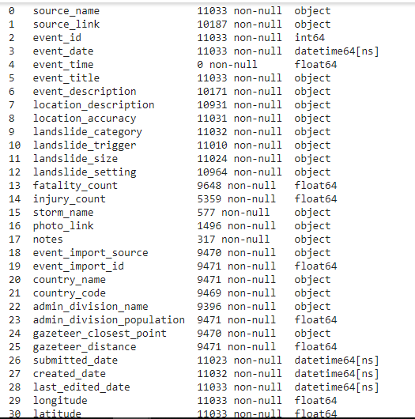
DATA OVERVIEW
These are the Columns that are included in the file, which are used
for detection and analysis.

Slide 5
Tools Used
For the project, We have used following tools:
Programming Language: Python
Platform/IDE : Jupyter Notebook, Google Colab
Machine Learning Libraries:
i) Random Forest
ii) Decision Tree
D) Other Python Libraries Used:
i) matplot – for graph
ii) Sckit learn – for data visualization
iii) numpy – for numeric processing
iv) pandas – reading/writing file
v)Geo pandas – world map output
vi)pydot, etc..

Slide 6
DATA PREPROCESSING AND DATA CLEANING
As the available dataset had some missing values and nan values so we replace the missing values with the median value of the column and in some case remove the entire row.
Column such as event_time does not have any data so we simply delete the column as it was of no use for the model.
Replace the unknown value with the appropriate one.
To change the categorical values into numeric value we use :
i) One Hot encoding and Label Encoding.
As event_date was in date and time data type so we separate out the year, month , day, minute, second and removed the redundant column showing same feature and choose unique 21 feature variables.
Target Class: Landslide_trigger. We want to predict the cause of landslide to help researcher to think more on this.

Slide 7
Feature Selection
There are unique 21 feature variable for building the
Machine Learning Model.
1. source_name
2. source_link
3. event_date
4. location_description
5. location_accuracy
6. landslide_category
7. landslide_size
8. fatality_count
9. injury_count
10. event_import_source
11. event_import_id
Country_name
admin_division_name
14.admin_division_population
15.Longitude
16.Latitude
17.event_year
18 event_month
19 event_week
20. event_day
21. event_hour

Slide 8
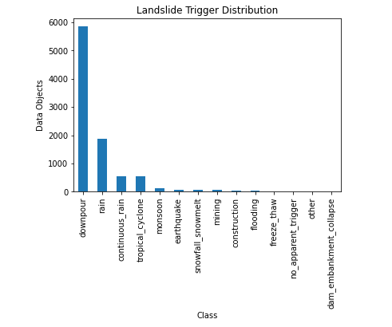
FINDINGS AND ANALYSIS
Fig: Landslide Trigger VS Count
The above graph demonstrates the landslide cause and its count.
As per the graph, the major cause of landslide as analyzed from the data is
due to downpour followed by rain and so on….

Slide 9
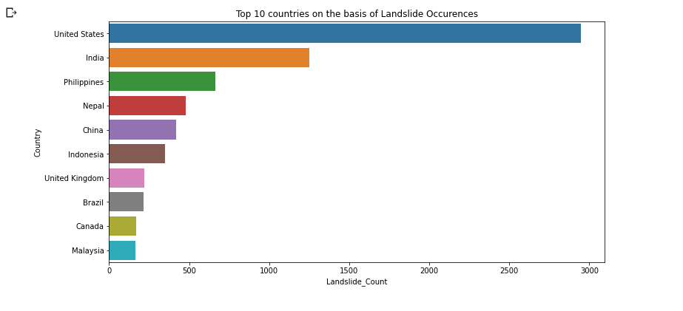
Contd…
Fig 2: Landslide Count VS Country
The above fig represents top 10 countries on the basis of landslide occurrences.
From this we found out that maximum landslide occurs in United States.
Similarly, minimum landslide occurred in Malaysia.

Slide 10
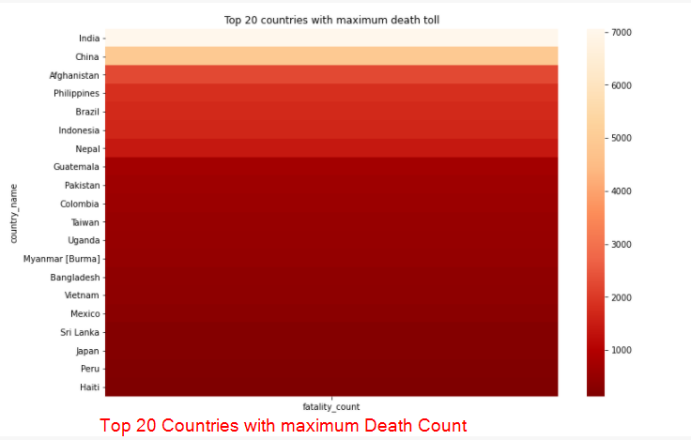
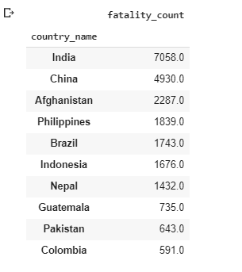
Contd…
Top 20 Countries VS Death Count
Among top 20 India has maximum death toll and Haiti has minimum death toll.

Slide 11
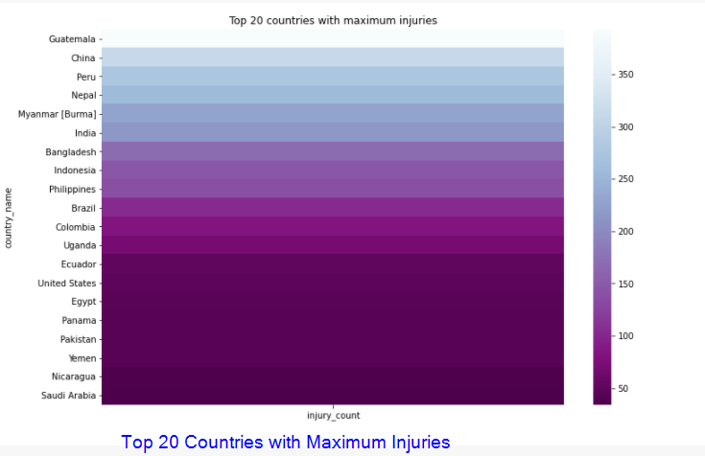
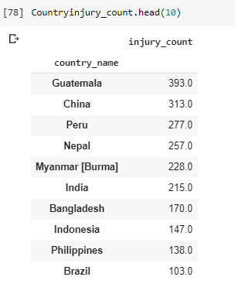
Contd…
Top 20 Countries VS Injury Count
Maximum number of injuries occurred in Guatemala and minimum
number of injuries occurred in Nicaragua and Saudi Arabia.

Slide 12
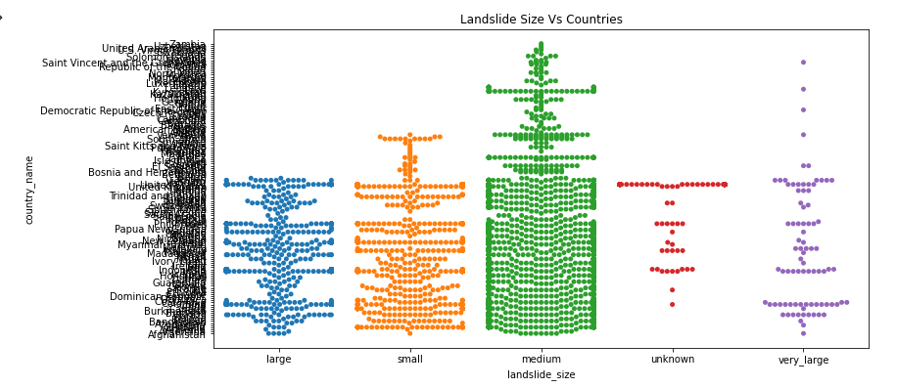
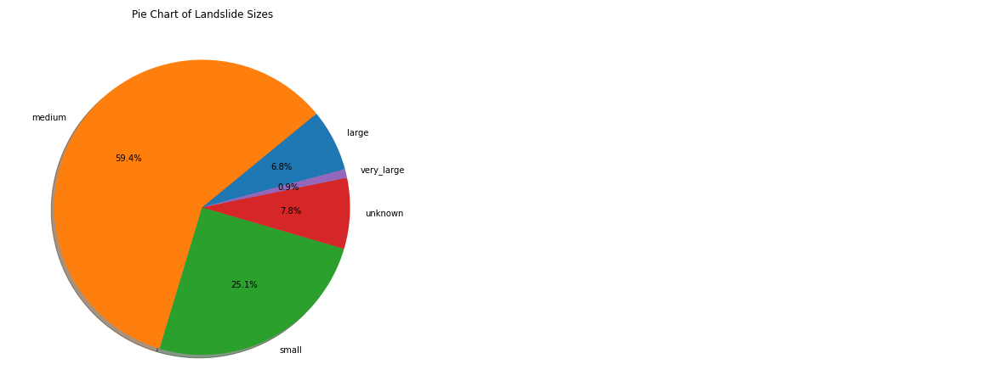
Contd…
Landslide Size VS Country
The above fig denotes size of landslide in accordance with countries name.
From the fig we can find out medium size landslides are occurred in the
maximum cases followed by the small one. Very large landslides are occurred
in less amount.

Slide 13
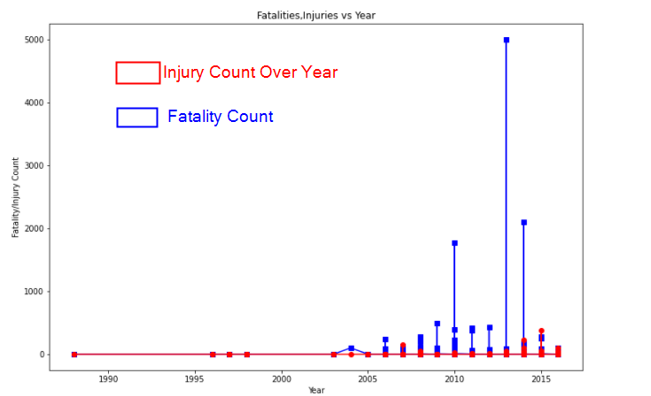
Contd…
Injury/Fatality VS Country
The above fig demonstrates fatality, injuries count according to year.
As we can see in the given figure the blue dot shows fatality and red dot shows injuries.
From this fig we can see that maximum fatality count was 5000 which was recorded
in the year 2013 A.D. Similarly, maximum injury count was recorded in year 2015 A.D.

Slide 14
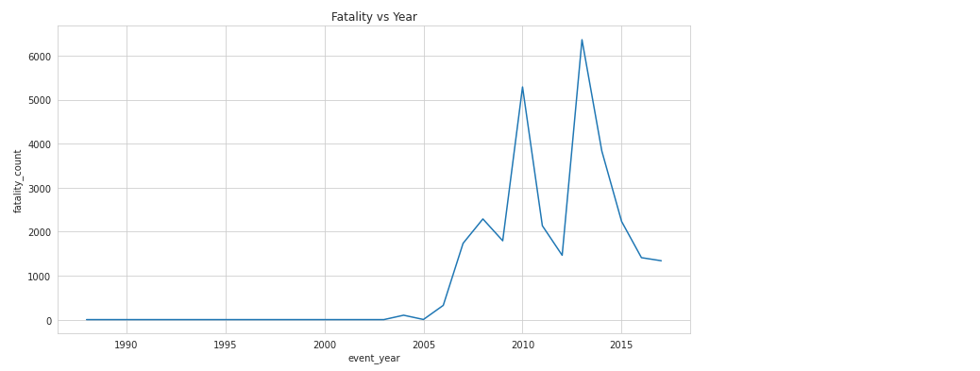
Fatality Count Vs Year
Contd…
Fig : Fatality Count Vs Year

Slide 15
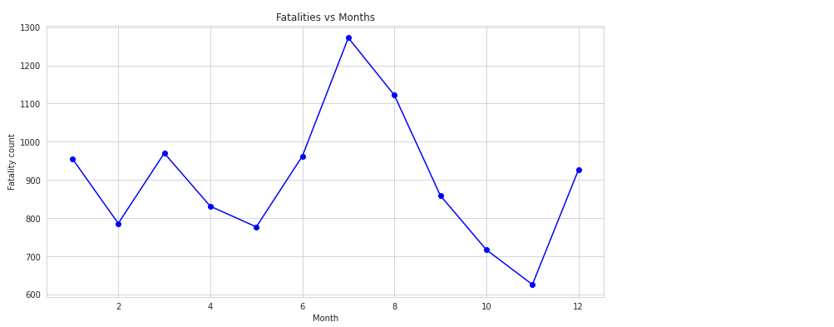
Fatality Count Vs Month
Contd…
Fig : Fatality Count Vs Month

Slide 16
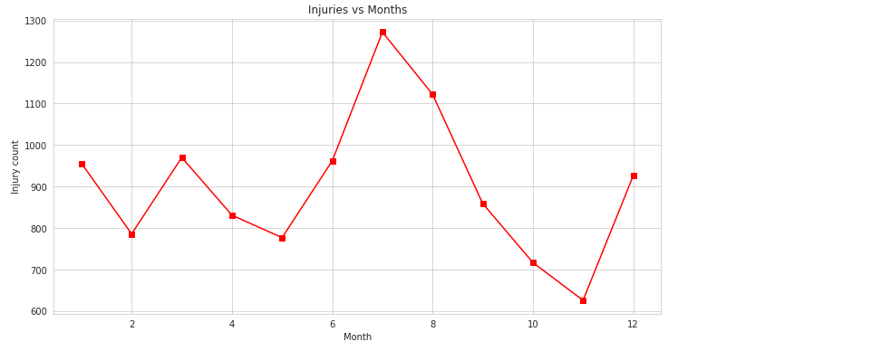
Contd…
Injuries Count Vs Month
Fig : Injuries Count Vs Month

Slide 17
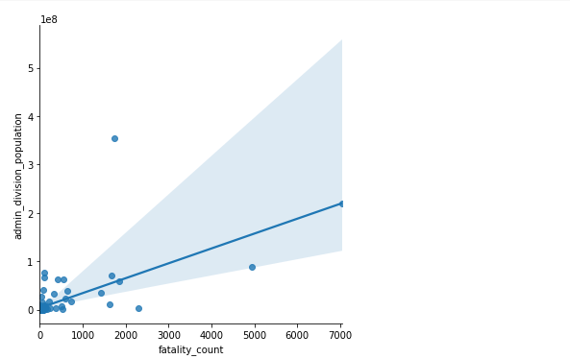
Contd…
Fatality Count VS admin_division_Population
Fig: Fatality Count VS admin_division_Population

Slide 18
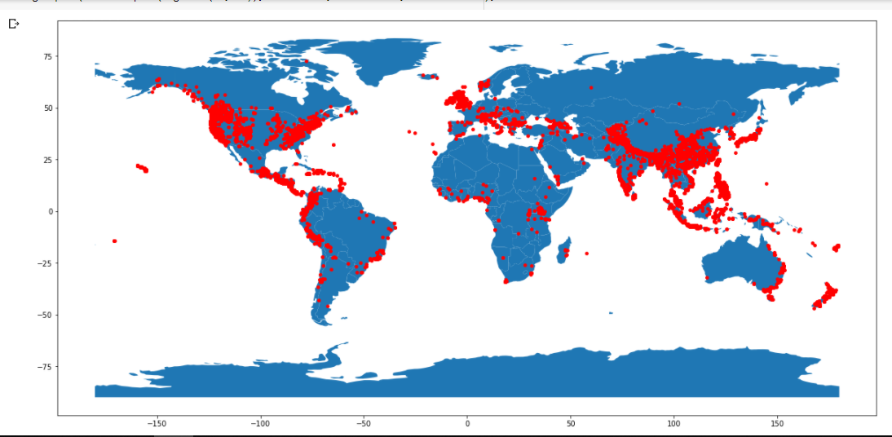
Landslide Vs Country on Map
Contd…

Slide 19
ANALYSIS STUDY AND INSIGHTS
Contd…
As per the Country Graph, We can clearly see that mountainous countries like Nepal, China have high landslide risk .
On the other hand, the land that is closer to the ocean i.e South America, US, Canada and Australia are also landslide prone due to tropical cyclones.
Through this study, researchers can be well prepared especially focusing on these places of the world.
Another insight for the Weather experts and atmosphere experts might be that they can study deeply about the causes of landslide ; which could be storm, heavy rainfall, snow melting, tropical cyclone, etc and can pass the alert message if any of these disaster is likely to occur in the near future.
As we can see clearly, the geographical position also plays a crucial role along with the country development status. There is less danger in african countries as compared to South Asian Countries, Europe and the US.

Slide 20
Contd…
MODEL DEVELOPMENT
In our project, we have developed two machine learning models that are random forest and decision tree.
The aim or abstract of this project is to predict the landslide cause through the feature variables such as Countryname, longitude, latitude, death counts, injury counts, landslide size, etc.
1. Random Forest:
In random forest model, we have got an accuracy of 77.46 %. So we assume the prediction of this model is more accurate as compared to decision tree.
2. Decision Tree:
In decision tree model, we have got an accuracy of 67 % which is not as accurate as that of Random Forest Model.

Slide 21
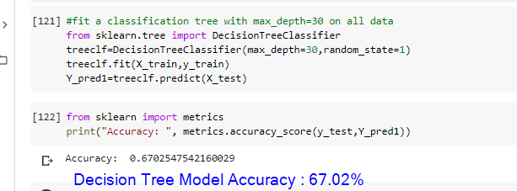
DECISION TREE
Fig: DECISION TREE MODEL ACCURACY
From the developed decision Tree model ,we have got 67% accuracy.

Slide 22
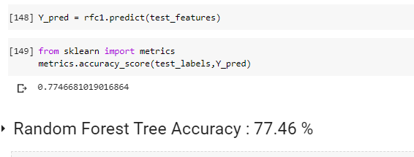
RANDOM FOREST
Fig: RANDOM FOREST MODEL ACCURACY
From the developed RANDOM FOREST Model ,we have got 77.46% accuracy which is more accurate as compared to Decision Tree.

Slide 23
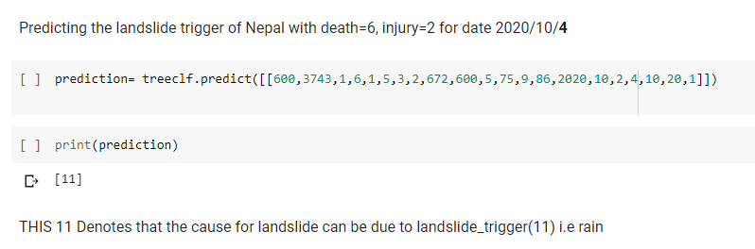
DECISION TREE VS RANDOM FOREST PREDICTION
Decision TREE predicting landslide trigger value to be due to rain.

Slide 24
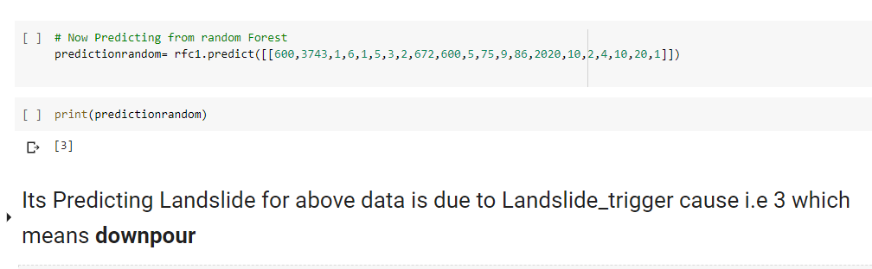
DECISION TREE VS RANDOM FOREST PREDICTION
Fig: Random FOREST MODEL predicts the cause for landslide as downpour for above feature input data.
Comparison Between the models:
For Same input feature values , the two models predict different landslide_trigger i.e rain and downpour by Decision Tree and Random Forest respectively.
As, Random Forest have high accuracy so we rely on random forest prediction i.e downpour for given prediction data set passed.

Slide 25
FUTURE ENHANCEMENT
The model can be launched in Web or App version for User Interaction.
2. We can use the image datasets of these areas which we have analyzed here, and attain better results.
3. The weather information could be integrated for the better model development resulting better model accuracy.
4. The geographical topology and climate data can be more helpful to enhance the project.

Slide 26
PROJECT LINKS
Github:
https://github.com/Smriti123-Tiwari/NASA-APP-CHALLENGE-2020
Google Drive:
https://drive.google.com/drive/folders/1RN6Db-cdMttpFNF20GKzCvC_9xF81se5?usp=sharing
For Video :
https://drive.google.com/drive/folders/1S5XDiWecDe6Vtl8xON146vEeGmPbg8bu?usp=sharing
Youtube Link:https://youtu.be/OBTuXF6gRFY

Slide 27
THANK YOU !!!
BRAIN BUDS , NEPAL

